Slide 1

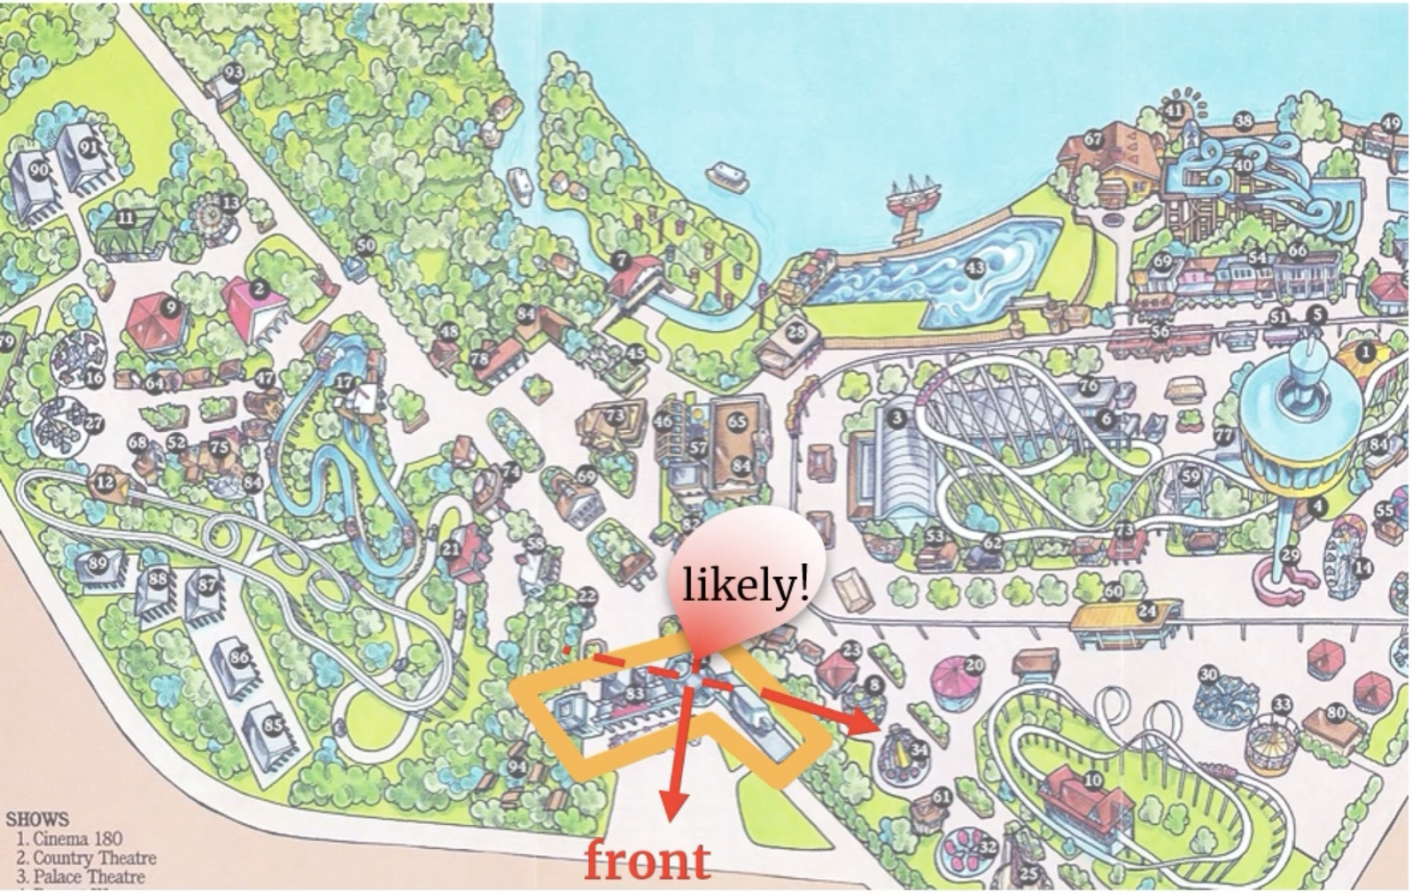
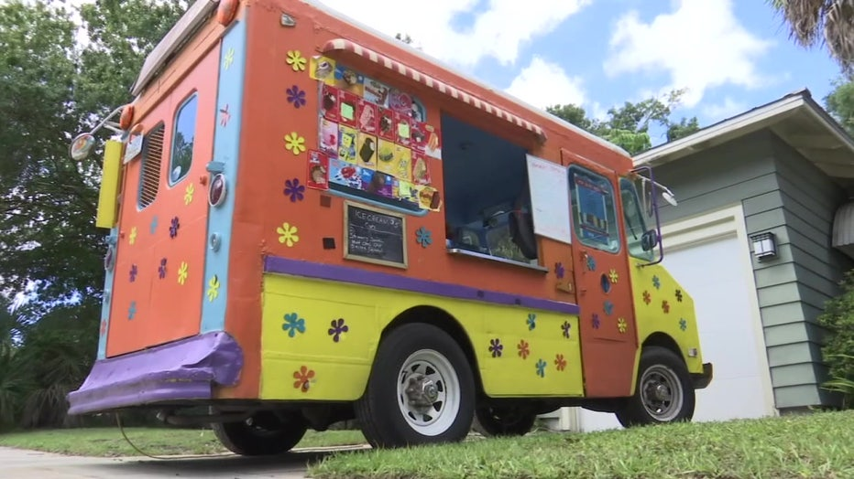
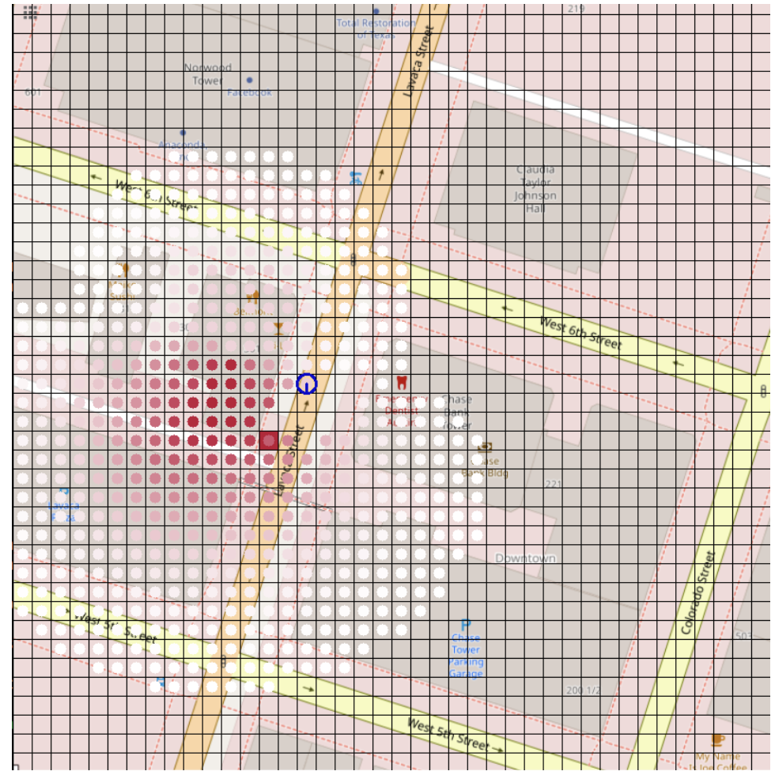
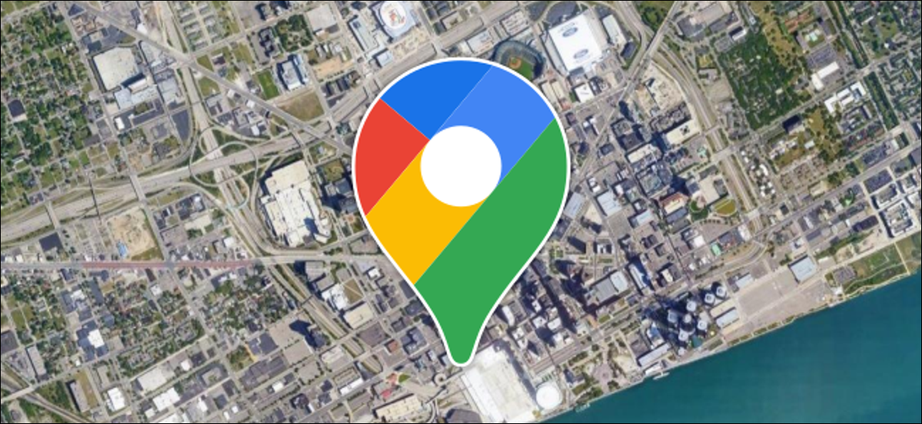
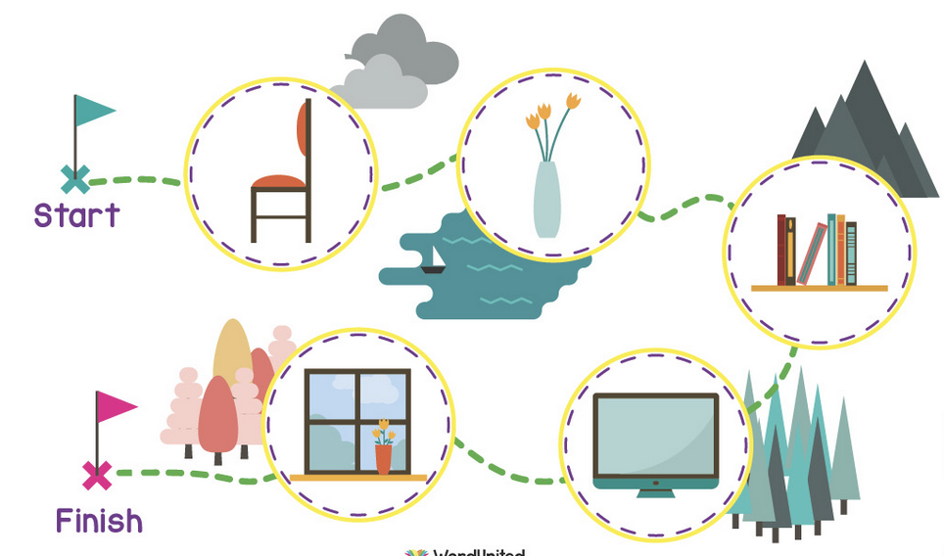
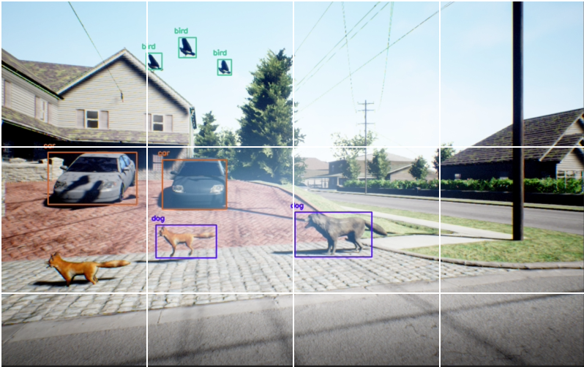
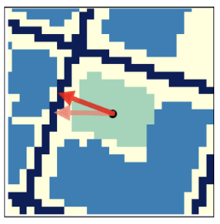
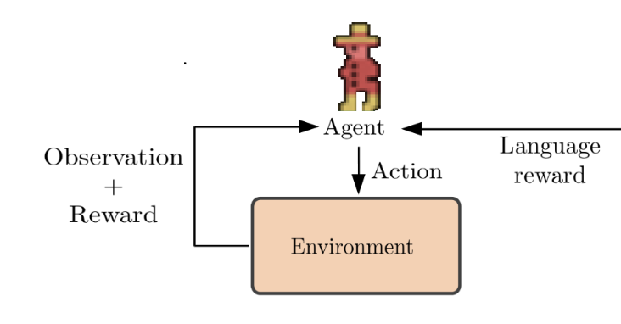
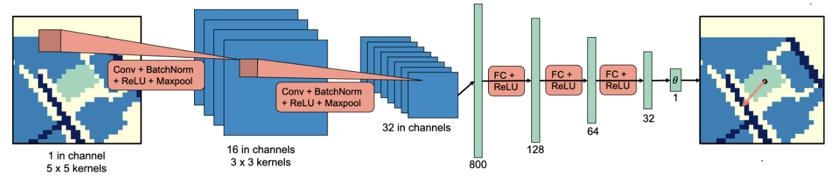
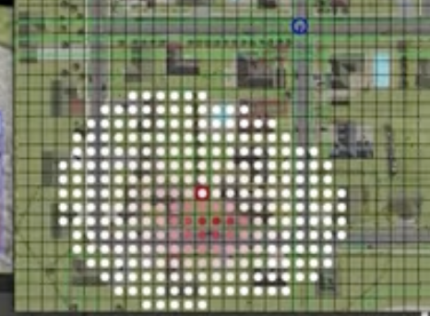
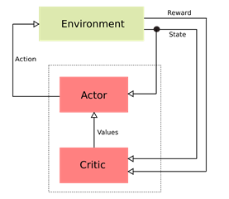
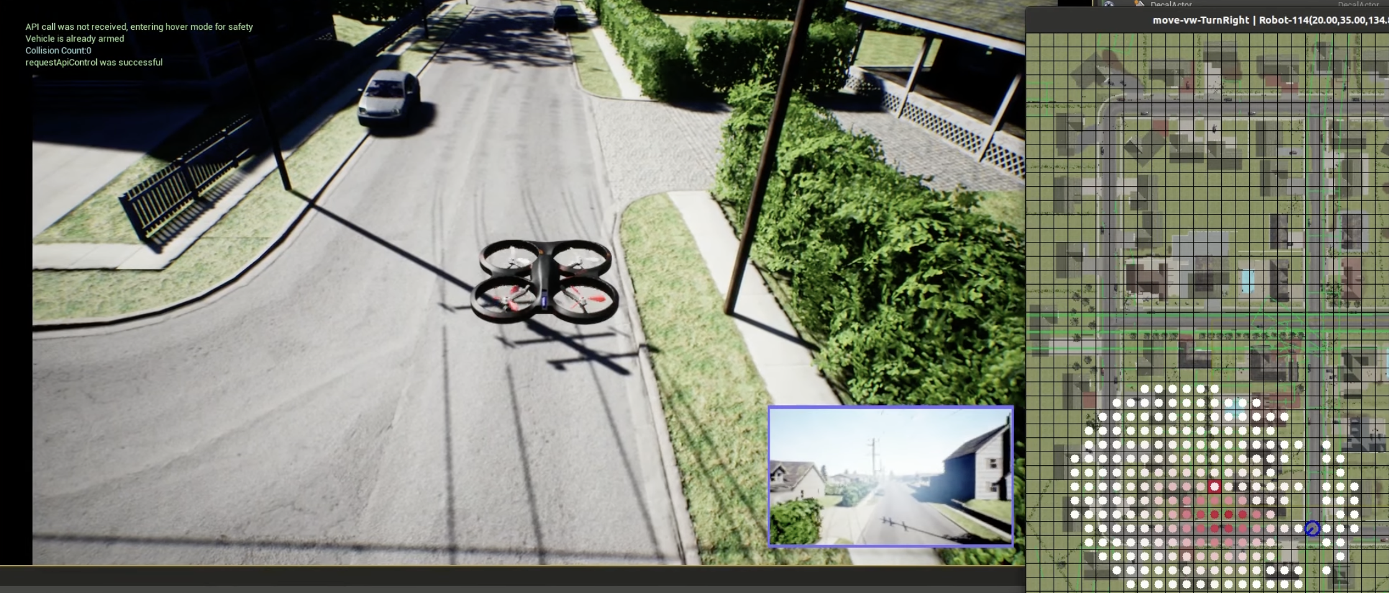
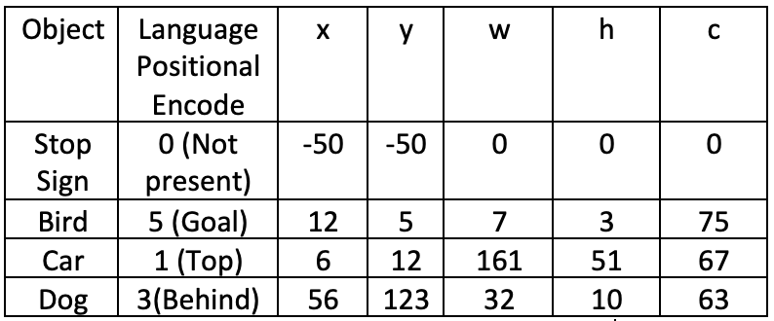
Spatial Language and Computer Vision based Object Search using DeepRL
Anirudha Paul & Donglin Liu
Motivation
Problem Definition
Goal
Let’s think about simple spatial information-
“Ice cream truck is behind the ticket booth.”
We can easily search the truck by looking at the map and observing the world.
But how can a robot do the same thing?
Navigate using the map
Given a map and a natural language cue, the agent should reasonably guess the part of the map that language refers to.
Then navigate without
the map only using CV and NLP
The agent needs to detect objects and associate them with the spatial language to navigate and pinpoint the goal object when it can no longer depend on the map.
State Goals
Make a distribution of beliefs over the map for possible location
Learn an optimum policy to navigate around the world by associating detected objects with spatial language
Insights from Problem Structure
Architecture
Learning frame of reference from Bitmap representation of the annotated map
Deterministic function
Goal 1 Architecture: Making a distribution of belief over the map for possible location (SLOOP) [1]
Distribution of belief over the map
If we can correlate the landmark with surrounding objects, the orientation of a map can be determined using that. Then it can be used to make belief over the space.
The object detection point can be used to make a good state representation for Reinforcement Learning. It also changes in correlation with your movement.
We can use the language as reward and give the agent small bits of reward if it finds the correlated objects appearing in the language. [3]
Environment
YoloV3
State
Language
New State
Reward calculation
Actor Critic Deep RL
Goal 2 Architecture: Learning an optimum policy to navigate around the world by associating detected objects with spatial language (Our own architecture)
Goal 1 Results
Goal 2 Results
Sample State Representation
(x, y) position on image
(w, h) height and width of object
C confidence level of the detected object
Deep RL Based Search
YoloV3 [3] is used for detecting objects
Drone is going to the place based on the belief system
Acknowledgements
References
[1] K. Zheng, D. Bayazit, R. Mathew, E. Pavlick and S. Tellex, "Spatial Language Understanding for Object Search in Partially Observed City-scale Environments," 2021 30th IEEE International Conference on Robot & Human Interactive Communication (RO-MAN), 2021, pp. 315-322, doi: 10.1109/RO-MAN50785.2021.9515426.
[2] Goyal, P., Niekum, S., & Mooney, R. J. (2019). Using natural language for reward shaping in reinforcement learning. arXiv preprint arXiv:1903.02020..
[3] Redmon, J., & Farhadi, A. (2018). Yolov3: An incremental improvement. arXiv preprint arXiv:1804.02767.
We would like to thank Nishka Pant, Kaiyu Zheng and Dr. Stefanie Tellex for their valuable input and guidance in different stages of this project.

